Slide 1
A REVIEW OF HOLY FAMILY BASILICA, NAIROBI UNDERGROUND PARKING STRUCTURE
BY
F16/1264/2018
KELLY MWEU CHANGILWA

Slide 2
Discussion Content
Introduction to underground structures.
Need for underground structures in the country.
Advantages of underground parking vs traditional parking.

Slide 3
Introduction to Underground Structures
Underground structures refer to constructions which have been done beneath the Earth’s natural ground surface either by drilling or by deep excavation.
Alternatively, an underground structure may be defined as one whose majority of floors lies within the earth’s crust

Slide 4
The need for underground structures
15,000 : The current parking space deficit in Nairobi City every single
day.
4% : The current population growth rate in Nairobi, Kenya as of 2023.
20,000: The expected parking space deficit in Nairobi by the year
2030.
Something needs to be done about these growing concerns, which don’t seem to be slowing down any time soon.
Source: Kenya National Bureau of Statistics, KNBS 2023

Slide 5
Advantages of Underground Parking over Traditional Parking
Underground Parking
Traditional Parking
Efficient land use as many parking space levels can be fitted in a small area of land.
Unaffected by wind lateral loads hence more structurally stable by design.
Higher vehicle security as they are difficult to access and secure.
Wastage of space during construction as it fits a single level of vehicle parking.
Tall parking structures are susceptible to wind loads, hence less structurally stable.
Generally less vehicle safety as they are easily accessible.

Slide 6
Advantages of Underground Parking over Traditional Parking
Underground Parking
Traditional Parking
Makes the city more aesthetically pleasing.
Increases revenue collection as underground parking systems can be monitored and billed easily.
Offer vehicle protection against harsh weather conditions, as they are enclosed in a structure.
Destroys the aesthetic value of the city as streets are full of vehicles.
Loses the city revenue by illegal street parking and collection inefficiencies.
Don’t offer protection against harsh weather conditions as vehicles are exposed.

Slide 7
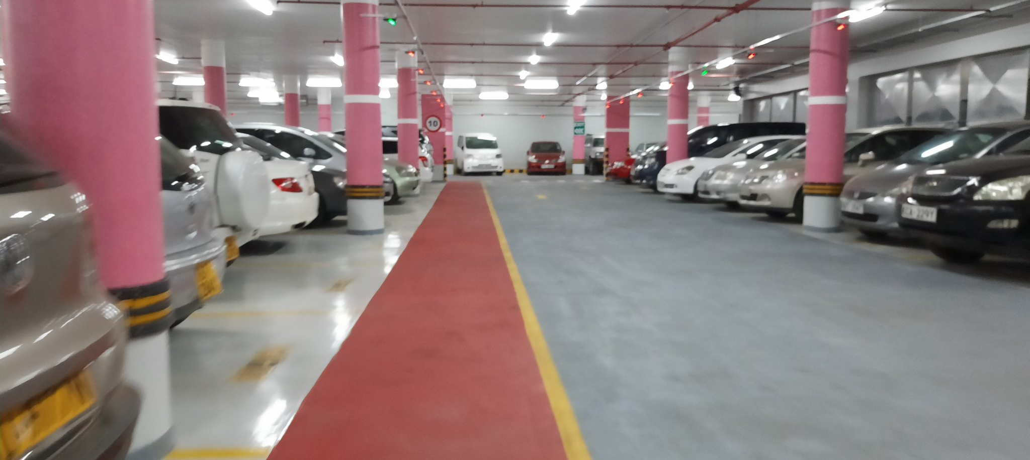
Holy Family Basilica Underground Parking, 2020
Underground parking creates more parking space whilst conserving constructible land.
Photo Source: https://twitter.com/mistersitati/status/1230154228649414661

Slide 8
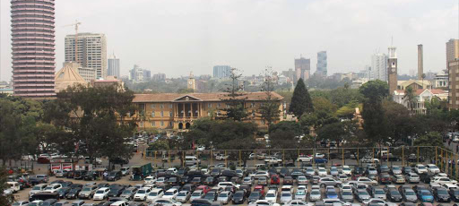
Supreme Court Parking, CBD Nairobi, full of cars.
Overground parking spaces in the city are wasteful of space and ugly
Photo Source: The Star Ke Newspaper, 2021

Slide 9
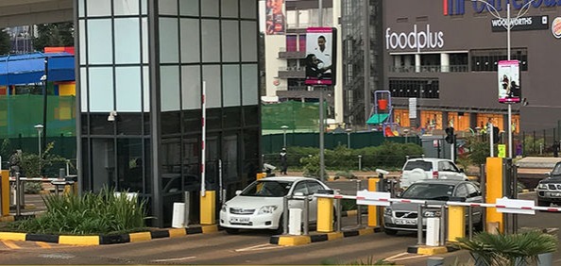
Two Rivers parking management system, underground exit
KAPS parking systems allow for easy revenue collection for the landlord(s)
Photo Source: parking.net 2018

Slide 10
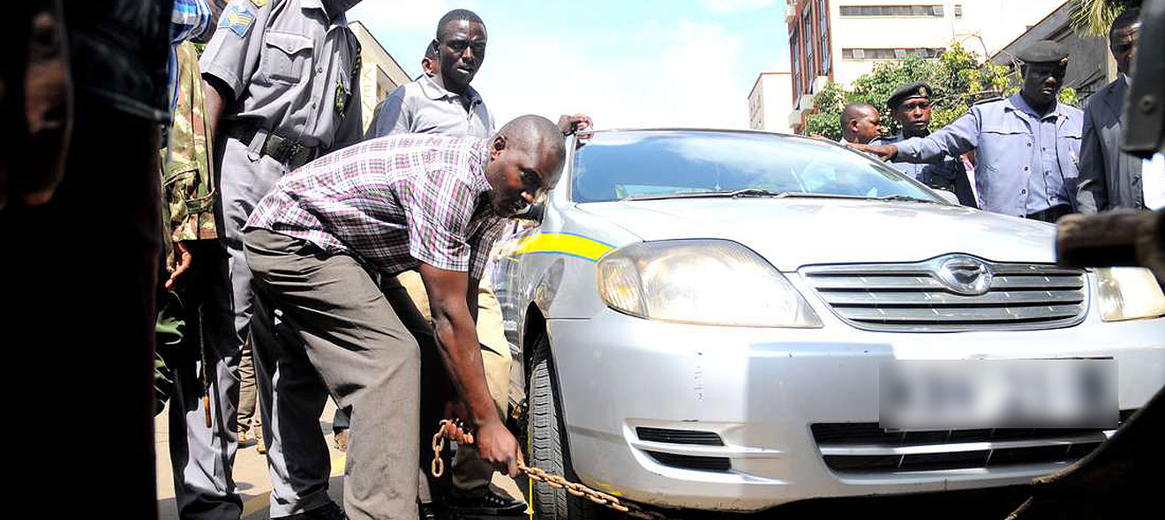
An illegally parked vehicle being clamped, NRB 2020, by ‘Kanjo’.
Illegal street parking is a major issue in Nairobi city.
Photo Source: Magaripoa.com

Slide 11
THANK YOU!!
This is the end of the slide show.

